Slide 1





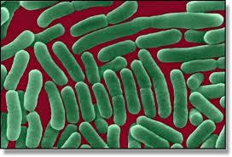

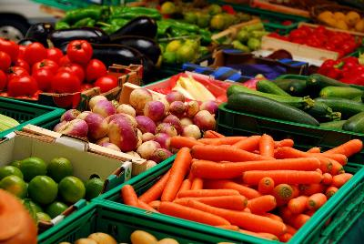

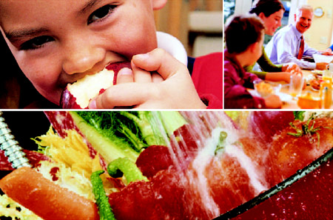


PSU E. coli Reference Center/(USDA)
International Workshop on Emerging Approaches for Typing, Detection, and Characterization of Escherichia coli
March 10, 2015
Enhanced Foodborne Outbreak Response: Augmenting FDA’s Contamination Traceback Efforts with WGS
1
Notes:
1

Slide 2
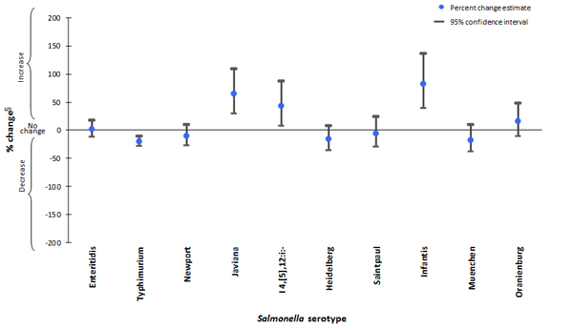
The Rise and Fall (and Rise) of the Salmonellae
http://www.cdc.gov/foodnet/data/trends/figures-2013.html

Slide 3

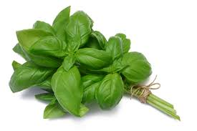
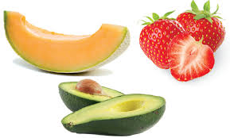
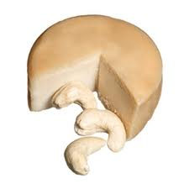

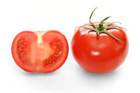
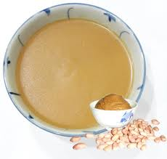

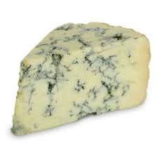
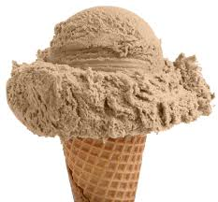
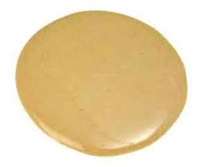
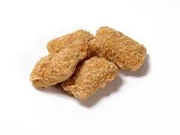
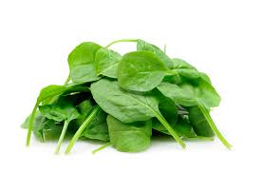
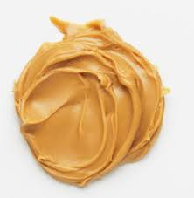
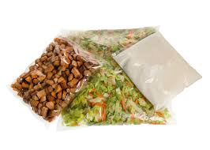
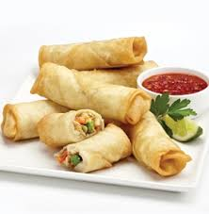
Select Recent FDA Related Recalls,
Withdrawals, and Alerts
02/24/2015 | Filberts (raw hazelnut) | Salmonella
02/12/2015 | Org Garlic Powder | Salmonella
02/10/2015 | Walnuts | Salmonella
02/03/2015 | Raw macadamia nuts | Salmonella
01/30/2015 | Beef Jerky Treats | Salmonella
01/30/2015 | Pecanettes | Salmonella
01/29/2015 | Org sunflower seeds | Salmonella
01/22/2015 | Seed mix | Salmonella
12/30/2014 | Pecan cookie pieces | Salmonella
12/19/2014 | cranberry crunch bars | Salmonella
12/03/2014 | Chile cheese enchilada | Salmonella
11/14/2014 | Brown rice flour | Salmonella
10/27/2014 | Cashew pieces | Salmonella
10/21/2014 | Carob powder | Salmonella
10/17/2014 | Shark cartilage suppl | Salmonella
07/26/2014 | Sweet paprika powder | Salmonella
07/25/2014 | Chocolate drink | Salmonella
06/26/2014 | Chia seed trailmix | Salmonella
06/06/2014 | ground malabar pepper | Salmonella
05/02/2014 | Chili powder | Salmonella
04/23/2014 | Ground Annato | Salmonella
04/10/2014 | Chile Molido Puro | Salmonella
04/09/2014 | Sweet basil | Salmonella
03/14/2014 | Organic basil | Salmonella
03/13/2014 | Sliced Fruit | Salmonella
02/11/2014 | Curly Parsley | Salmonella
02/07/2014 | Tomatoes | Salmonella
01/22/2014 | Cheese | Salmonella
12/31/2013 | cashew cheese products | Salmonella
12/27/2013 | Cheese | Salmonella
11/26/2013 | Blue cheese | Salmonella enteritidis
05/09/2013 | Sesame Paste | Salmonella
03/18/2013 | Chocolate Bars | Salmonella
03/18/2013 | Pet Food | Salmonella
http://www.fda.gov/Safety/Recalls/

Slide 4
Some perspective on the food supply
Tracking and Tracing of food pathogens
    Almost 200,000 registered food facilities (2/14)
      81,574 Domestic and 115,753 Foreign
    More than 300 ports of entry
    More than 130,000 importers and more than 11 million import lines/yr
    In the US there are more than 2 million farms
Notes:
4

Slide 5
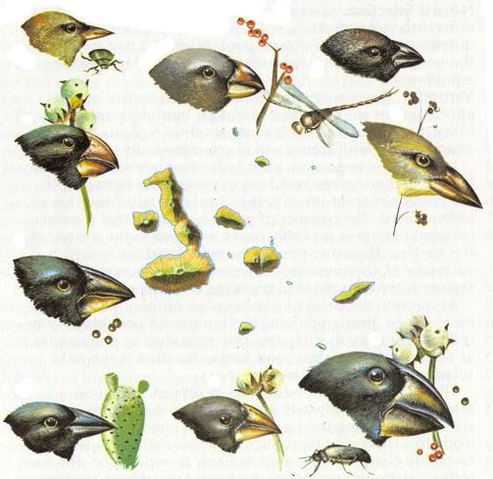
This from 1859, Darwin's, On the Origin of Species
“It is obvious that the Galapagos Islands would be likely to receive colonists, whether by occasional means of transport or by formerly continuous land, from America; and the Cape de Verde Islands from Africa; and that such colonists would be liable to modification;— the principle of inheritance still betraying their original birthplace"
With WGS, we now have the potential to discern those birthplaces…

Slide 6
What Can WGS Tell Us?
Are bacteria found in food/environmental samples a “match” to clinical isolates?
  Match may not imply causation, contaminated ingredient
Endemic contamination in a facility
  Bacteria isolated are identical over time, before and after cleanup efforts
Source of contamination
  Database contains isolates from different countries, regions, states
Anti-Microbial Resistance, Virulence, Pathogenicity

Slide 7
FDA WGS Application to Actual Food Contamination Events
Montevideo black and red pepper
Senftenberg black and red pepper
Enteritidis shell/liquid eggs
Heidelberg ground turkey
Heidelberg chicken broilers
Heidelberg chicken livers
Enteritidis custard
Bareilly tuna scrape
Tennessee peanut butter/peanut butter paste
Typhimurium peanut butter
Braenderup peanut butter/nut butter
Tennessee cilantro
Agona dry cereal
Agona papaya
Newport tomatoes
Newport environmental
Kentucky - Cerro dairy/dairy farms
Anatum spices/pepper flakes
Javiana cantaloupes
Saintpaul hot peppers
4,5,12: i –
Lmono cantaloupes
Lmono queso cheese
Lmono potato salad
Lmono artisanal cheeses
Lmono avocados
Lmono ricotta
Lmono celery/chix salad
Lmono smoked fish
Lmono other herbs
Lmono peaches
Cronobacter infant formula
V para oysters
EcO157:H7 lettuce
STEC beef
…Numerous other taxa

Slide 8
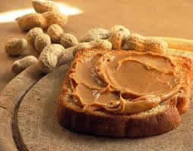
Salmonella Tennessee &
Peanut Butter
Comparative Genomic Analysis Of Peanut Butter-associated Salmonella Tennessee Provides Evidence For Assigning Contamination Sources Among Multiple And Contiguous Foodborne Outbreaks
Authors: E. W. Brown¹, C. Keys¹, E. Strain¹, Y. Luo¹, C. Wang¹, T. Muruvanda¹, C. Pirone¹, S. Musser¹, M. Wilson², M. Allard¹;
¹U.S. FDA, College Park, MD, ²Forensic Sci. Program Western Carolina Univ., Cullowhee, NC
In 2007, nearly 630 persons infected with an outbreak strain of Salmonella Tennessee from 47 states.
Strongly associated with consumption of peanut butter from single facility.
Outbreak strain of Salmonella Tennessee isolated from several opened and unopened jars of peanut butter and from environmental samples obtained from the plant.
In 2008-2009, a second outbreak was reported and also associated with peanut butter from an unrelated facility.
Investigation determined that an S. Tennessee isolate detected during this second outbreak had a pulse-field gel electrophoresis (PFGE) pattern that was indistinguishable from the earlier 2007 S. Tennessee outbreak strains.
Back in Time

Slide 9
2112EMeat/Bone Meal (TX, 2008)
20920JE00 Hydrolyzed Veg (2010)
0R322DFUrine (IA, 2006)
0R23F22Stool (IA, 2007)
DLK213123Peanut Butter (GA, 2009)
-02393JDQBlood Meal (2010)
SAKLD0123Fishmeal (TX, 2009)
23390 Fishmeal (TX, 2008)
KDLSCFeather meal (TX, 2008)
2006/07 IA Isolates are more closely associated
of PB Event #2 (2009)
-0934IJRCotton Seed (TX, 2009)
903149Wound (MA, 2006)
GR99Stool (MA, 2006)
GR98Urine (MA, 2006)
03094Soy Bean (TX, 2009)
39JKDE32Peanut Butter (GA, 2007)
2006 MA Isolates are outside of PB Event #1
OO3232-0 Peanut Butter (GA, 2007)
3094Stool (MA, 2005)
2005 MA
TR9595Stool (IA, 2006)
IOE33Peanut Butter (GA, 2007)
2004 MA
90349Stool (MA, 2004)
IDFKDFK0-4 Peanut Butter (GA, 2007)
9039344Peanut Butter (GA, 2007)
2004/5 isolates are in clade with PB Event #1 (2007)
Q9E092394Peanut Butter (TN, 2007)
2939233Peanut Butter (GA, 2007)
FOR0333Stool (IA, 2006)
FR02381Peanut Butter (GA, 2007)
934883Peanut Butter (GA, 2007)
2004 IA
0989084Stool (IA, 2004)
2004 TN
23233Human (TN, 2004)
1112234Peanut Butter (GA, 2007)
Clinical isolate pair clusters together
0000223Stool (IA, 2006)
39939Human (IA, 2006)
4444413333Roaster Drain (GA, 2007)
Env isolate pair clusters together
29239ER00Peanut Butter (GA, 2007)
-EK2 Roaster Drain replicate (GA, 2007)
W34E55Peanut Butter (IA, 2006)
019 Plant–Floor Squeegee replicate (GA, 2007)
Env isolate pair clusters together
009123222Plant-Floor Squeegee (GA, 2007)
472382Peanut Butter (GA, 2007)
3742Peanut Butter (TN, 2007)
203948Peanut Butter (GA, 2007)
837234Peanut Butter (GA, 2007)
0.06

Slide 10
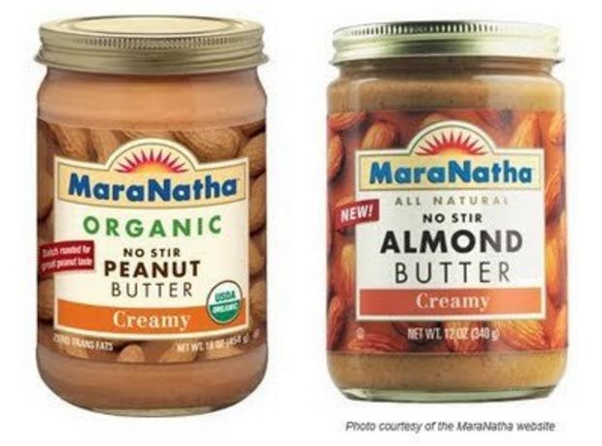
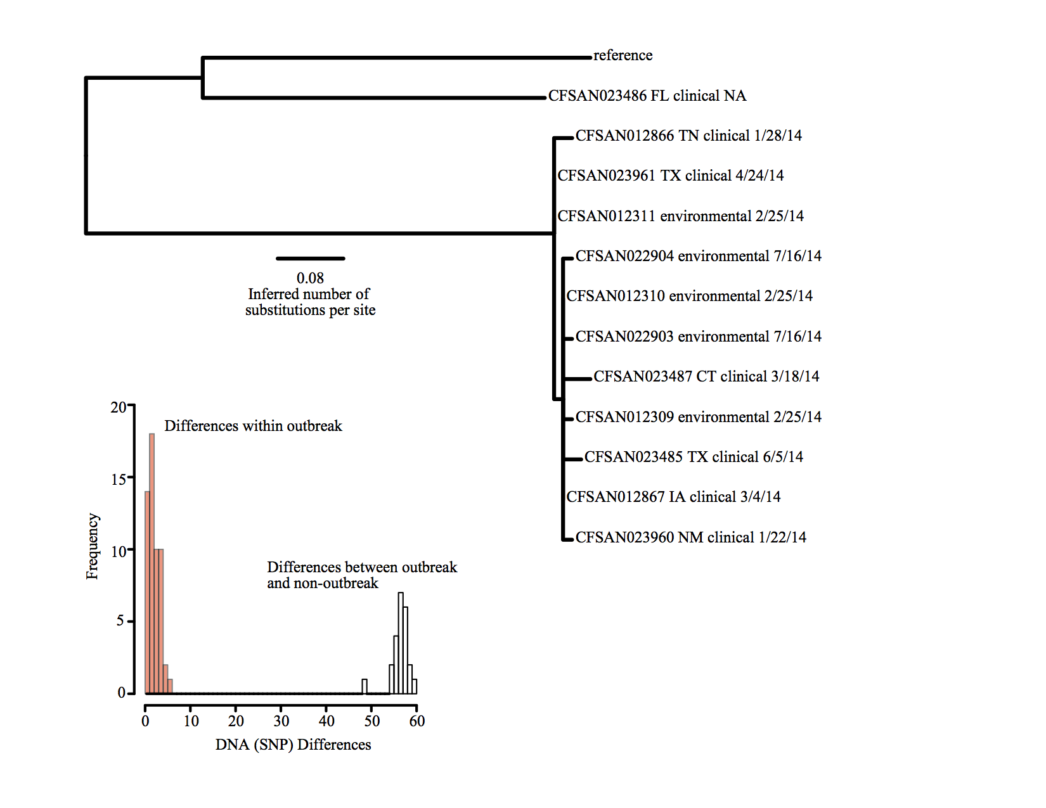

An increased degree of certainty that comes with matching strains of pathogens through whole genome sequencing allowed for detection of this Salmonella contamination event in nutbutter across several states with low level contamination and a widely distributed product.
SUMMER 2014
Across missing links

Slide 11
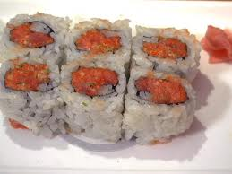
S. Bareilly Outbreak
April-June 2012
Around the World
12/23/02 Frozen Raw Esomus Swaison Whole Vietnam
11/13/09 Babgladeshi Fresh Water Fish (Bacha) Bangladesh
12/05/05 Frozen Rock Lobster Tails United Arab Emirates
03/01/06 Frozen Crab with Claws Sri Lanka
07/12/02 Frozen Undeveined Shrimp India
07/06/05 Fresh Canaloupe USA
04/17/08 Fennel Seeds United Arab Emirates
06/27/11 Organic Black Pepper India
02/26/04 Frozen Raw Peeled Shrimp India
08/08/05 Frozen Whole Tilapia Thailand
02/22/10 Ground Red Pepper USA
10/17/11 Punjabi Cheole Spice India
02/17/11 Red Chili Powder Pakistan
11/17/10 Shell-on Shrimp Sri Lanka
02/08/07 Frozen Baila Bangladesh
05/13/03 Frozen Raw Shrimp India
09/18/08 Sand Goby Fish Vietnam
1109/30/10 Sesame Seeds India
03/17/08 Coriander Powder India
09/17/03 Coriander Powder India
10/12/01 Frozen Rohu Rish India
08/01/06 Turmeric Powder India
10/19/07 Coriander Powder India
07/09/01 Pabda Fish Bangladesh
11/18/05 Cayenne Pepper India
04/06/10 Fish Stomach Vietnam
07/30/01 Whisker Fish Vietnam
05/01/72 Poultry Feather Meal USA
03/14/05 Coriander Bangladesh
05/14/09 Irrigation Water USA
09/08/08 Chili Powder Thailand
1974-08- Nonfat Dry Milk Unknown
03/12/01 Raw Shrimp Vietnam
05/09/07 Ginger Powder India
12/29/04 Frozen Shrimp India
12/06/04 Crushed Chilis India
08/17/06 Lobster Tails Taiwan
11/08/02 Cumin Powder India
04/22/05 Sesame Seed India
12/27/02 Frozen Shrimp India
11/16/05 Hilsa Fish Thailand
02/05/08 Kheer Mix Pakistan
01/14/10 Frozen Fish India
09/09/10 Chili Powder India
06/01/09 Chili Powder India
1975-07- Frog Legs Unknown
08/18/11 Coconut India
03/10/10 Coriander Mexico
06/26/00 Scallops Indonesia
05/08/72 Feather Meal USA
Environmental USA
03/27/02 Shrimp India
05/02/72 Poultry Meal USA
10/17/00 Shrimp India
Environmental USA
Environmental USA
Clinical MD
Clinical MD
Clinical MD
Clinical MD
Clinical MD
Clinical MD
Clinical NY
Clinical MD
Clinical MD
Clinical MD
Clinical NY
Clinical NY
Clinical NY
Clinical NY
Clinical NY
Clinical NY
Clinical NY
Clinical NY
Clinical NY
Clinical NY
Clinical NY
Clinical NY
Clinical NY
Clinical NY
Clinical NY
Clinical NY
ATCC 9115
Clinical NY
Clinical NY
Clinical NY
Different PFGE than the outbreak pattern
Same PFGE but not part of the outbreak
Outbreak Isolates
MD isolates – in green
NY isolates – in purple
Notes:
We captured as much S. Bareilly diversity as possible from FDA strain collections.
One MD isolate had a different PFGE than the outbreak and was from 2011
Another MD isolate had the same PFGE as the outbreak, but was also from 2011. Hmmmmm…

Slide 12
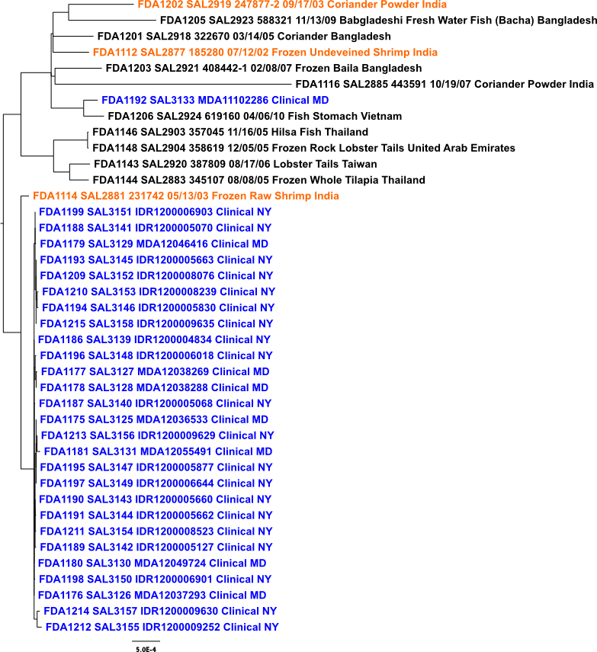
S. Bareilly Phylogeny
FDA1202 SAL2919 Coriander Powder India
FDA1203 SAL2921 Frozen Baila Bangladesh
FDA1201 SAL2918 Coriander Bangladesh
FDA1112 SAL2877 Frozen Undeveined Shrimp India
FDA1203 SAL2921 Frozen Baila Bangladesh
FDA1116 SAL2885 Coriander Powder India
FDA1206 SAL2924 Fish Stomach Vietnam
SAL3133 Clinical MD
FDA1146 SAL2903 Hilsa Fish Thailand
FDA1148 SAL2904 Frozen Rock Lobster Tails United Arab Emirates
FDA1143 SAL2920 Lobster Tails Taiwan
FDA1155 SAL2889 Fresh Cantaloupe USA
FDA1144 SAL2883 Frozen Whole Tilapia Thailand
FDA1159 SAL0955 Unknown Environmental USA
SAL3132 Clinical MD
FDA1114 SAL2881 Frozen Raw Shrimp India
FDA713 SAL0949 Environmental USA
FDA1160 SAL0956 Environmental USA
FDA1145 SAL2898 Chili Powder Thailand
FDA1107 SAL2914 Pabda Fish Bangladesh
FDA1141 SAL2884 Frozen Crab with Claws Sri Lanka
SAL3140 Clinical NY
FDA1150 SAL2439 Frog Legs Unknown
FDA1157 SAL2908 Ground Red Pepper USA
FDA1140 SAL2895 Red Chili Powder Pakistan
SAL3130 Clinical MD
FDA1147 SAL2886 Fennel Seeds United Arab Emirates
FDA1165 SAL2894 Raw Shrimp Vietnam
FDA1161 SAL2876 Whisker Fish Vietnam
FDA1163 SAL2879 Frozen Raw Esomus Swaison Whole Vietnam
SAL3126 Clinical MD
FDA1164 SAL2887 Sand Goby Fish Vietnam
FDA1117 SAL2888 Frozen Shrimp India
FDA1139 SAL2890 Kheer Mix Pakistan
FDA1123 SAL2901 Sesame Seeds India
SAL3139 Clinical NY
FDA1118 SAL2891 Coriander Powder India
FDA1124 SAL2902 Coconut India
FDA1132 SAL2916 Shrimp India
FDA1142 SAL2910 Shell-on Shrimp Sri Lanka
SAL3148 Clinical NY
20-25 SNPs
FDA1200 SAL2917 Cumin Powder India
FDA1129 SAL2911 Organic Black Pepper India
FDA1131 SAL2915 Frozen Rohu Rish India
SAL3128 Clinical MD
FDA1207 SAL2925 Chili Powder India
FDA1126 SAL2906 Ginger Powder India
FDA1120 SAL2896 Crushed Chilis India
FDA1138 SAL2900 Coriander Mexico
SAL3127 Clinical MD
FDA1119 SAL2893 Frozen Fish India
FDA1156 SAL2892 Irrigation Water USA
FDA1121 SAL2897 Sesame Seed India
FDA364 ATCC 9115
SAL3157 Clinical NY
FDA1149 SAL2438 Nonfat Dry Milk Unknown
FDA1152 SAL2434 Poultry Meal USA
PFGE
Match
FDA1154 SAL2436 Feather Meal USA
FDA1153 SAL2435 Poultry Feather Meal USA
SAL3131 Clinical MD
FDA1137 SAL2913 Scallops Indonesia
FDA1130 SAL2912 Cayenne Pepper India
FDA1128 SAL2909 Punjabi Cheole Spice India
SAL3155 Clinical NY
FDA1204 SAL2922 Chili Powder India
FDA1125 SAL2905 Turmeric Powder India
FDA1115 SAL2882 Frozen Raw Peeled Shrimp India
FDA1127 SAL2907 Shrimp India
SAL3151 Clinical NY
FDA1113 SAL2880 Frozen Shrimp India
FDA1202 SAL2919 Coriander Powder India
FDA1201 SAL2918 Coriander Bangladesh
FDA1112 SAL2877 Frozen Undeveined Shrimp India
SAL3129 Clinical MD
FDA1203 SAL2921 Frozen Baila Bangladesh
<=5 SNPs
FDA1205 SAL2923 Bangladeshi Fresh Water Fish (Bacha) Bangladesh
FDA1116 SAL2885 Coriander Powder India
FDA1206 SAL2924 Fish Stomach Vietnam
SAL3141 Clinical NY
SAL3133 Clinical MD
FDA1146 SAL2903 Hilsa Fish Thailand
FDA1148 SAL2904 Frozen Rock Lobster Tails United Arab Emirates
SAL3145 Clinical NY
FDA1143 SAL2920 Lobster Tails Taiwan
FDA1144 SAL2883 Frozen Whole Tilapia Thailand
FDA1114 SAL2881 Frozen Raw Shrimp India
SAL3150 Clinical NY
SAL3152 Clinical NY
SAL3140 Clinical NY
SAL3130 Clinical MD
110-130 SNPs
SAL3126 Clinical MD
SAL3139 Clinical NY
SAL3158 Clinical NY
SAL3148 Clinical NY
SAL3128 Clinical MD
SAL3127 Clinical MD
SAL3153 Clinical NY
SAL3157 Clinical NY
SAL3131 Clinical MD
SAL3155 Clinical NY
SAL3151 Clinical NY
SAL3146 Clinical NY
SAL3129 Clinical MD
SAL3141 Clinical NY
SAL3145 Clinical NY
SAL3152 Clinical NY
SAL3142 Clinical NY
SAL3158 Clinical NY
SAL3153 Clinical NY
SAL3146 Clinical NY
SAL3142 Clinical NY
SAL3143 Clinical NY
SAL3143 Clinical NY
SAL3154 Clinical NY
SAL3144 Clinical NY
SAL3154 Clinical NY
SAL3156 Clinical NY
SAL3125 Clinical MD
SAL3149 Clinical NY
SAL3147 Clinical NY
SAL3144 Clinical NY
SAL3156 Clinical NY
SAL3125 Clinical MD
SAL3149 Clinical NY
SAL3147 Clinical NY

Slide 13
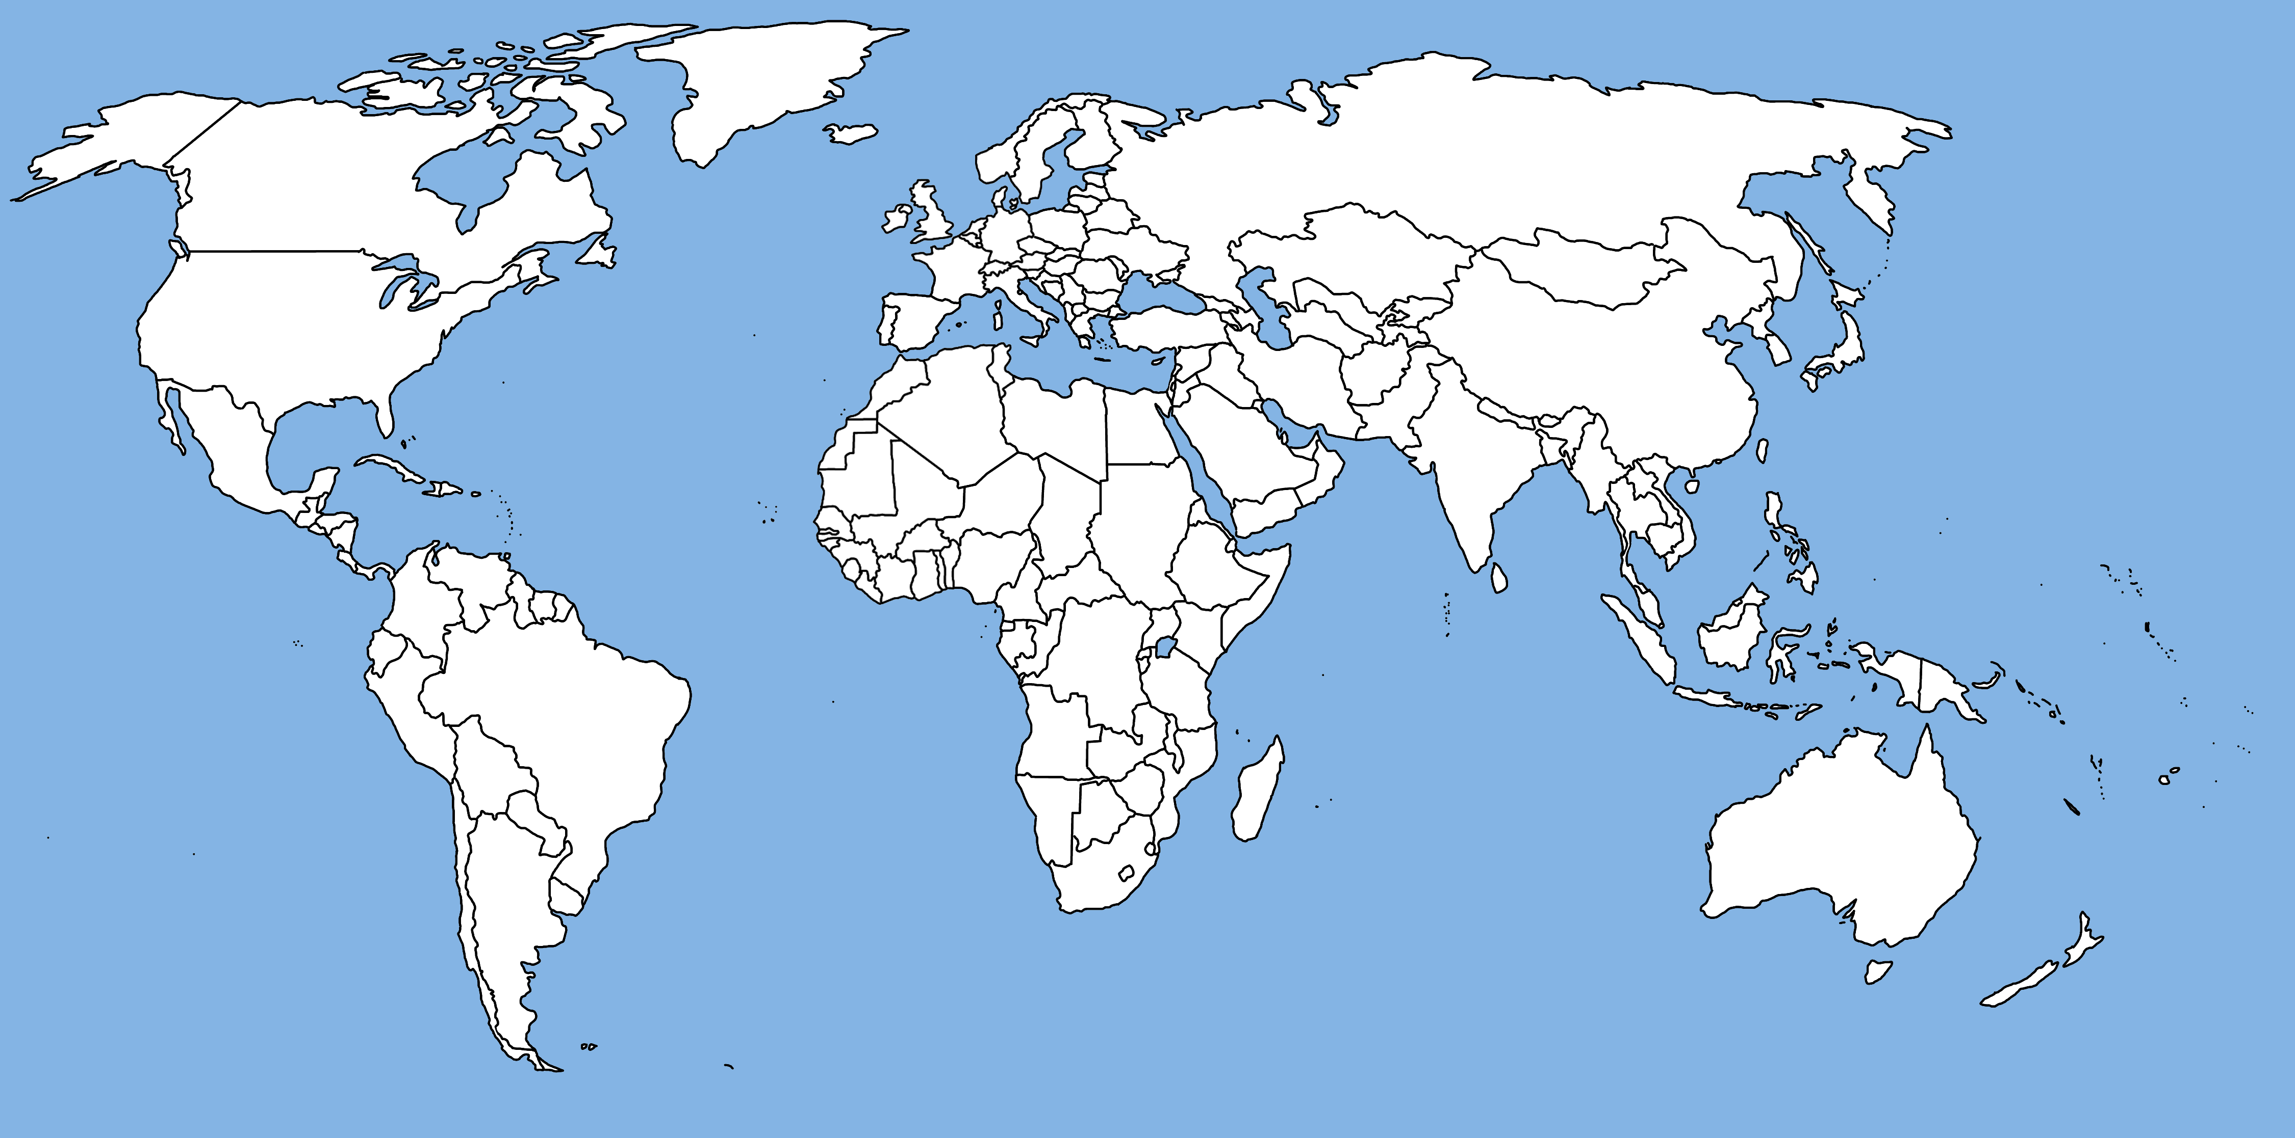
PFGE identical in red
NGS distinguishes geographical structure among closely related Salmonella Bareilly strains
Notes:
But, here’s the global distribution of PFGE matches – where to start looking? Our new genomics group at FDA was asked to assist – we shotgun sequenced all the clinical and reference strains, reconstructed the phylogeny and found that this reference isolate was most closely related to the outbreak lineage.

Slide 14
Notes:
For all-to-all shortest paths, India appears the most times on the paths.
Some locations have a score of 0 such as Mexico, Fl, MS, etc. This is due to not
having an outgoing edge. These locations become a terminal and not appear on any
of the shortest paths between two other locations. India has many incoming and outgoing
edges which makes it an important node as can be seen by its betweenness score.

Slide 15
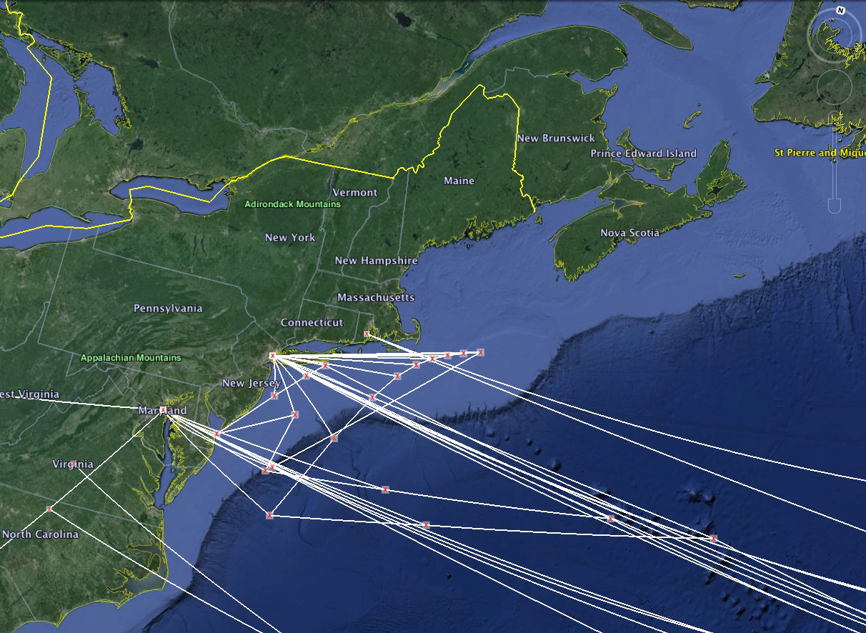
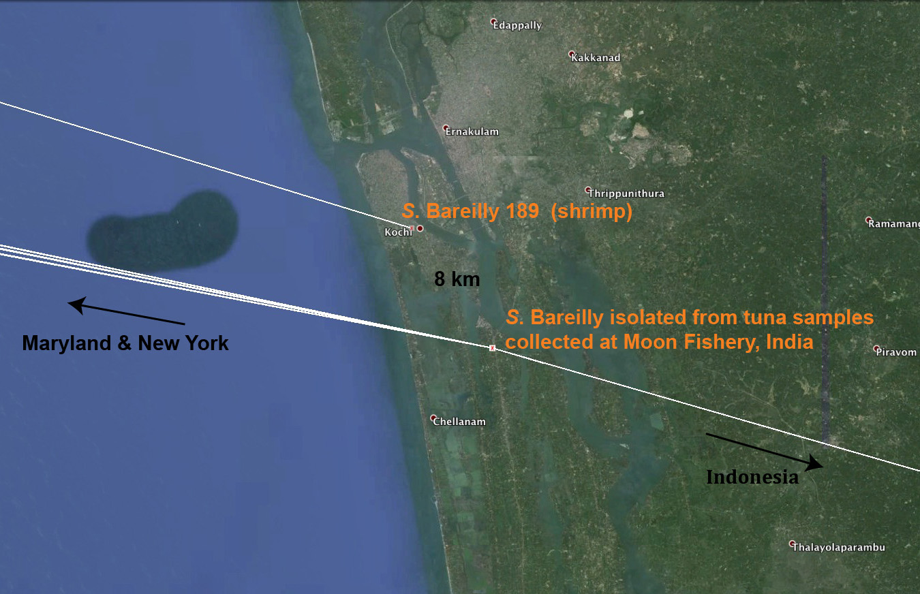

Slide 16
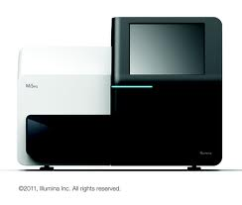
Applications of WGS in the Food Safety Environment
Delimiting scope and traceback of food contamination events (Track-N-Trace)
Quality control for FDA testing and surveillance (Confidence in Regulatory Actions)
Preventive control monitoring for compliance standards (the “repeat offender” project)
ID, geno/pheno typing schemes (AST,Serotyping, VP) (CVM,CDRH,CFSAN) – risk assessment and adaptive change in Salmonella and Listeria
Metagenomics for probiotics, GAP improvements, and culture independent characterization of pathogens

Slide 17
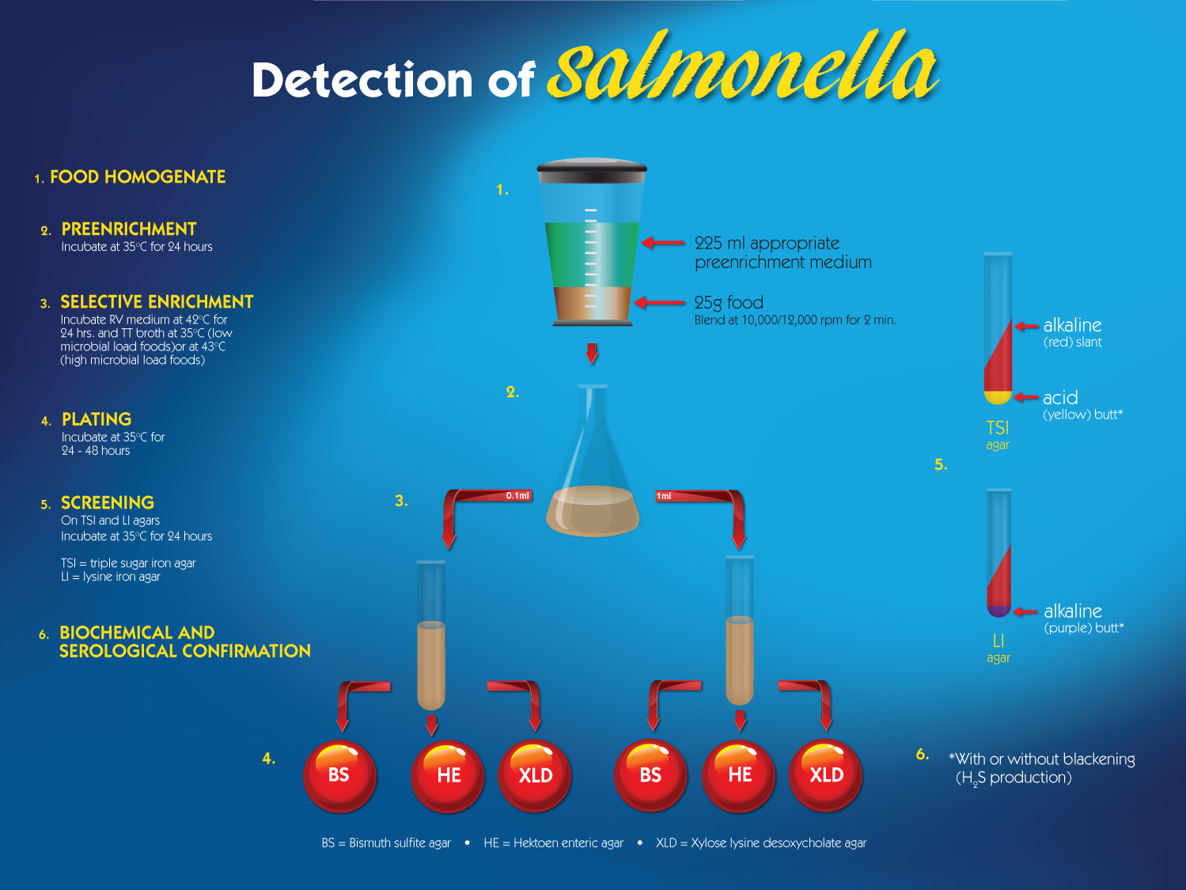

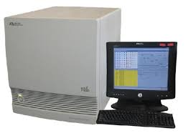
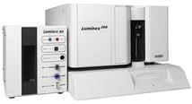
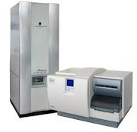
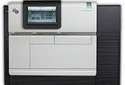
‘OMICS INTEGRATION INTO FDA’s FOOD TESTING PROGRAM
qPCR
BioPlex
WGS
MALDI-
TOF

Slide 18

Acknowledgments
FDA –CFSAN
Marc Allard Rebecca Bell Peter Evans
Steve Musser Andrea Ottesen James Pettengill
Ruth Timme Jie Zheng Charlie Wang
Christine Keys Cong Li Justin Payne
Errol Strain Yan Luo Chris Grim Hugh Rand
George Kastanis Darcy Hanes Tim Muravunda
FDA OFVM David White Palmer Orlandi
FDA Division of Field Sciences Keith Iams Tim McGrath
NYPH Bill Wolfgang Kimberly Musser and colleagues
MPH Alvina Chu, Bob Myer, Julie Haendiges MNDPH Dave Boxrud and colleagues at DOH and AG
FDH Anita Wright Judy Johnson VCS Denise Toney et al
ADPH Victor Waddell Dave Engelthaller Paul Keim
WDH Brian Hyatt Chen Li William Glover
CDC Cheryl Tarr, Eija Trees, Duncan MacCannell, John Besser UMD Jianghong Meng, Guojie Cao Maria Hoffmann
National Institutes of Health
David Lipman (NCBI) Martin Shumway (NCBI)
Jim Ostell (NCBI) William Klimke (NCBI)
Illumina
Lisa Alves Susan Knowles Omayma Al-Awar and colleagues
CLC Bio David Michaels Cecilia Boysen and colleagues
QUESTIONS
Notes:
18

